Slide 1

QR CODE ATTENDANCE
Staff

Slide 2
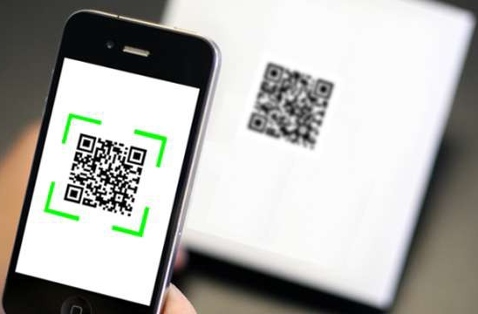
QR Attendance (Cont.) for Web Base + Mobile
1. Introduction
2. Scope (add more detail on web development)
3. Team member and responsibility
4. Structure Project

Slide 3
1- Introduction
Staff attendance system using QR code
Most of all company are temporarily banning the use of biometrics in checking the staff' daily time records because of Covid-19 problem, the use of QR codes is a great technological substitute for checking their daily time records.
Since the staff only need to scan their corresponding QR code attendance, the chance of infecting each other with a communicable disease lessens.
Because of that, offices can use a QR code attendance into their attendance checking routines for a smooth and safe daily time recording.
Benefits of using a QR code attendance
QR codes are known to be the cost-efficient technological tool that many businesses use in keeping a contactless operation.
With the use of a QR code attendance system, institutions can implement a secure and safe attendance checking system without the need of spending more in maintaining them.

Slide 4

2 - Scope
There are a various functionalities of staff and attendance are useful to be added in QR attendance app.
By concerning of the time, the limitation of functionalities is set to the following:
Manage staff, assign staff to session schedule
Manage attendance policy
Consolidate attendance by schedule/session via mobile
Be able to create temp link of session attendance
Produce reports

Slide 5

3- Team member and responsibility
1. Tek Thida
Role: Project manager Tasks: Responsible for Initiating, planning, organizing, and directing the completion project within scope
2. Man Keomorakort Role: Web developer
Tasks: Develop web application
3. Huort Pengleng
Role: Mobile developer
Tasks: Develop mobile application
4. Sun Malen
Role: UX/UI prototype (web)
5. Sok Rathana
Role: Tester, test attendance mobile application
6. Vong Sovanndara
Role: Tester, test web application

Slide 6
Structure Project
Login
Time In/Out
Home page with 2 menu:
- Time In/Out
- Attendance list
Left menu:
- Staff info
- Time In/Out
- Attendance list
- Logout
Scan QR code
Try again
Match
No
Absent form message
Yes
Present form success
Attendance upload into database
End

Slide 7
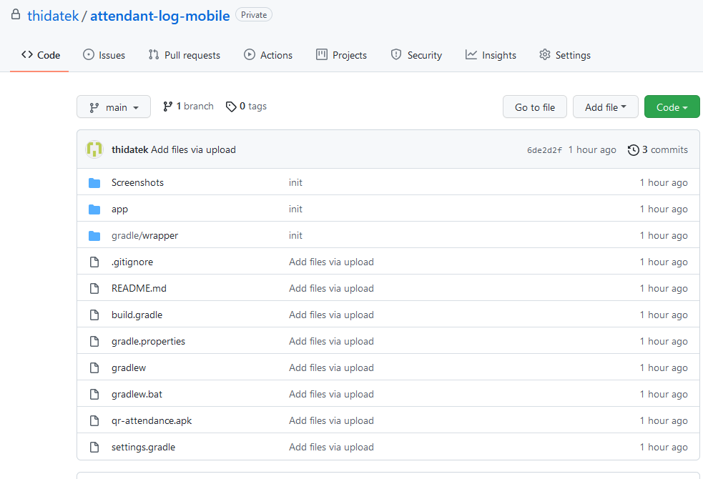
gitHub project
https://github.com/thidatek/attendant-log-mobile.git

Slide 8
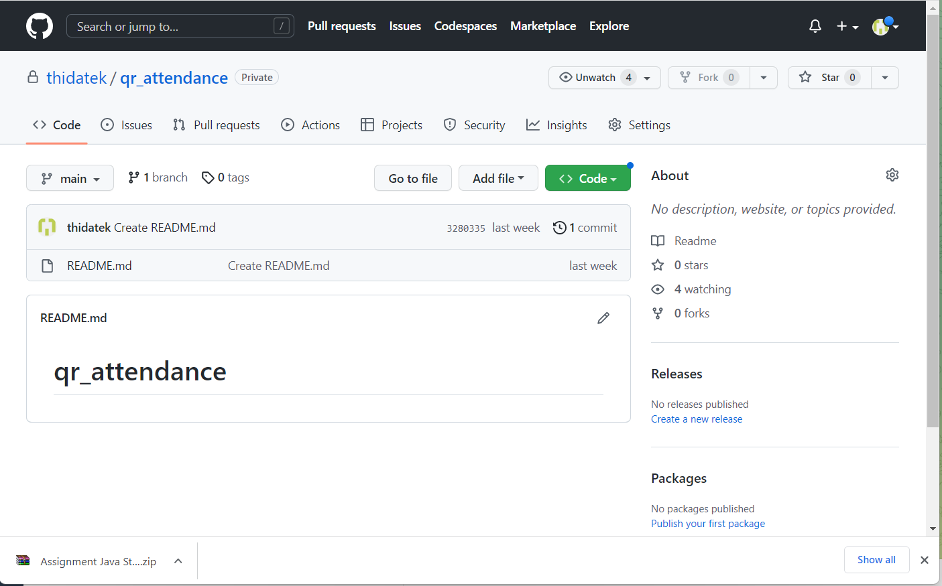
gitHub project
https://github.com/thidatek/qr_attendance.git

Slide 9
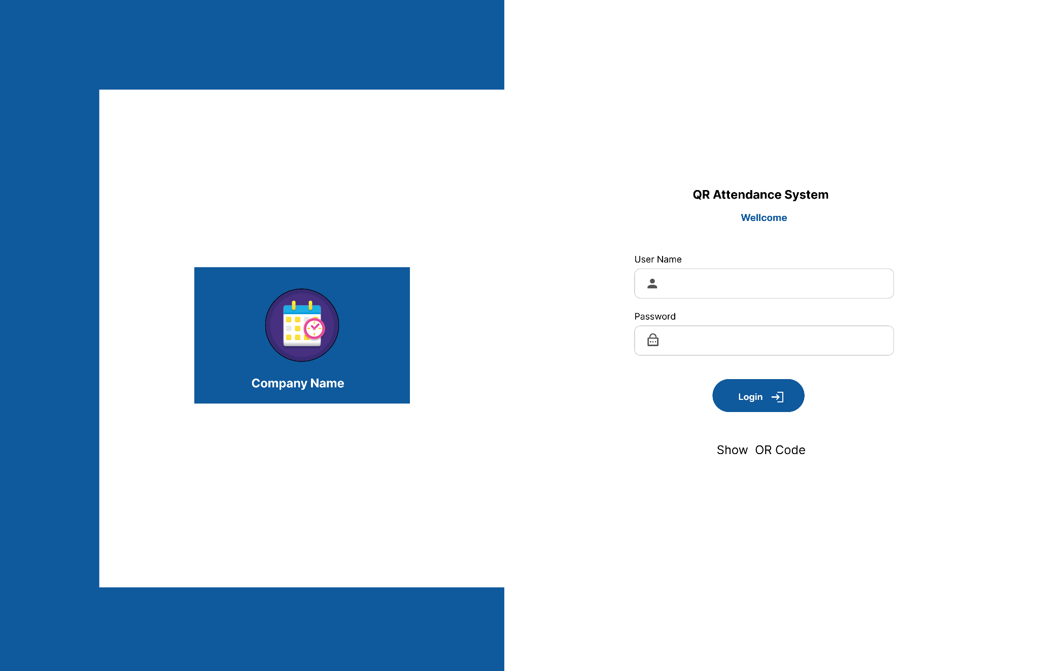
Prototype Web application

Slide 10
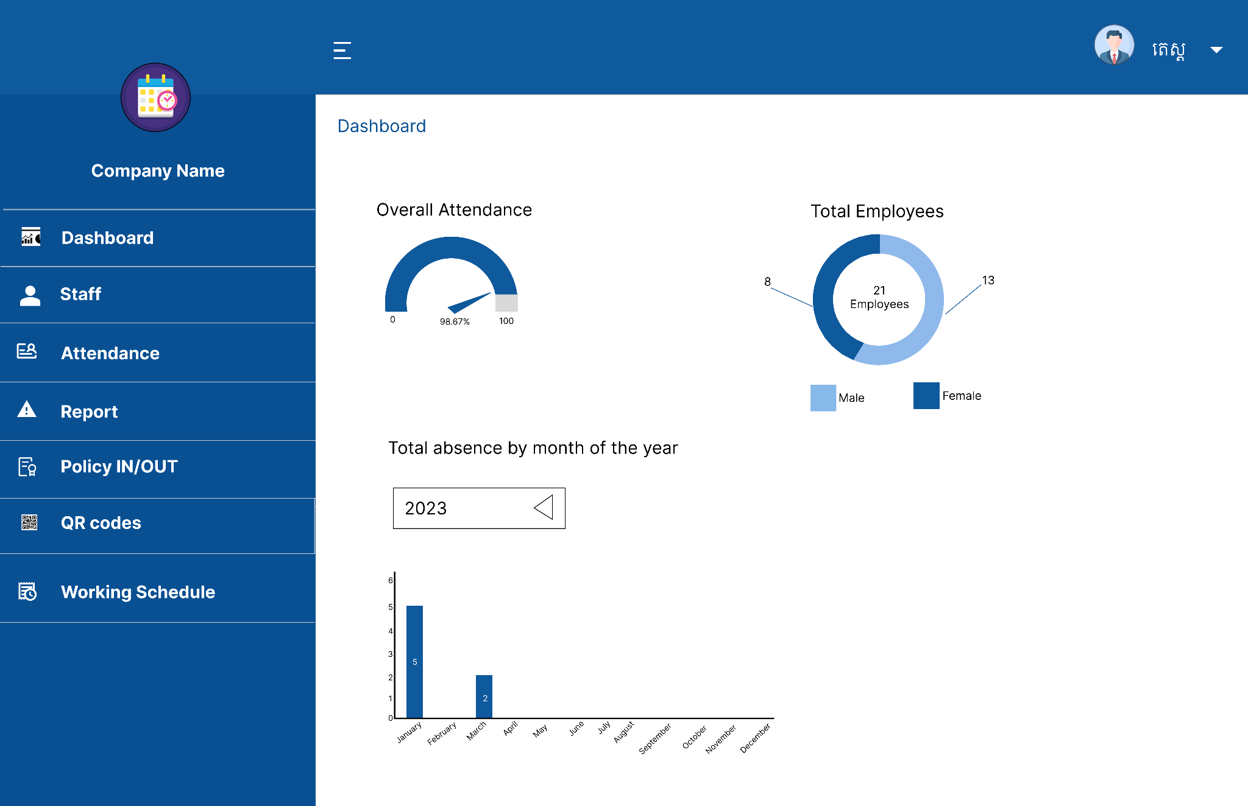
Admin Dashboard

Slide 11
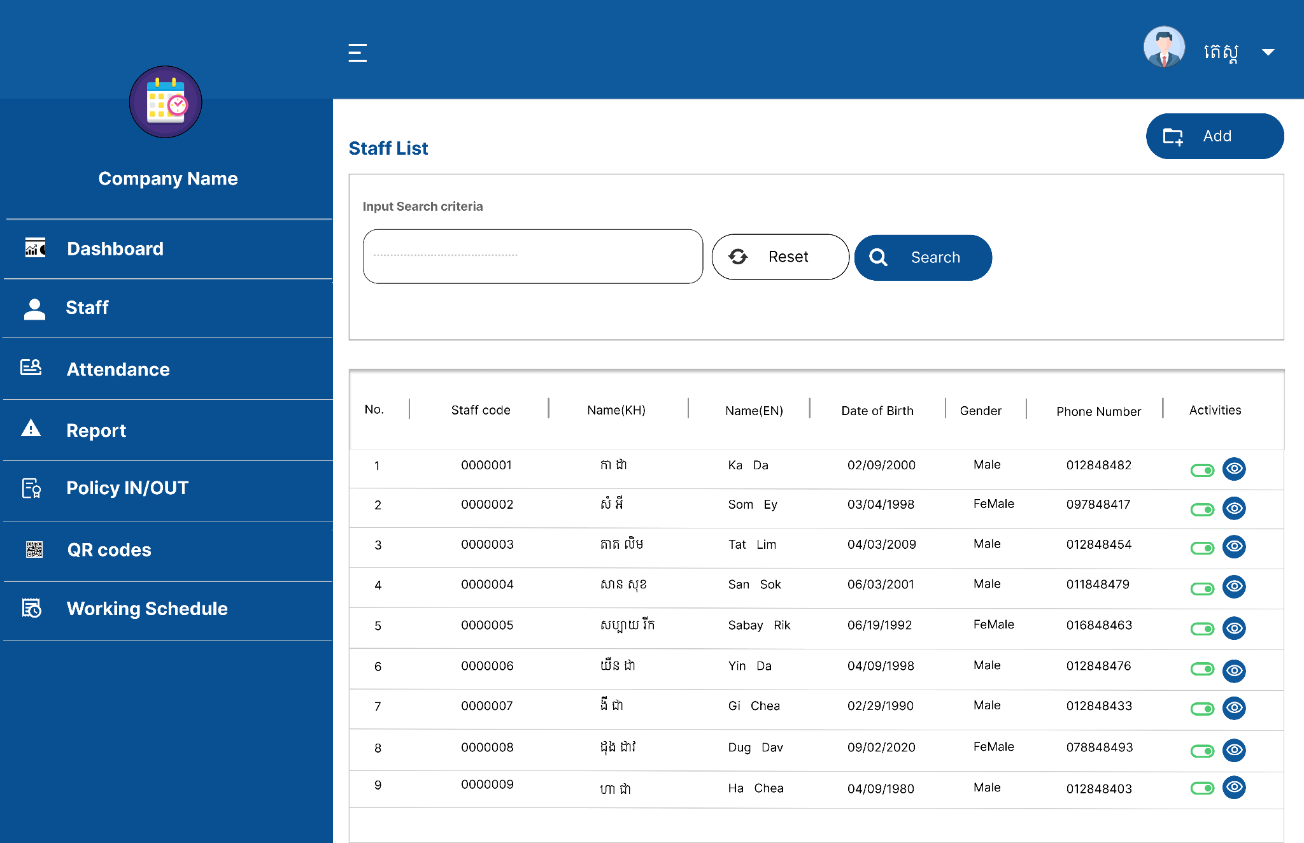
Staff List

Slide 12
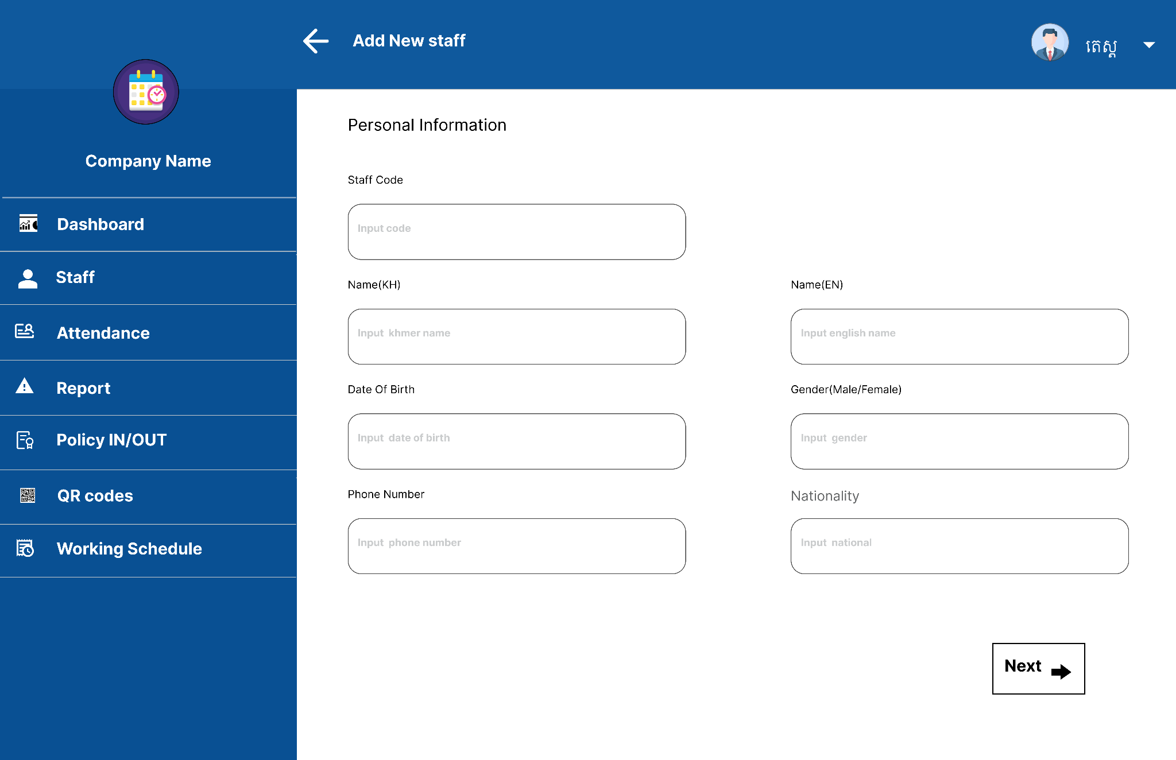
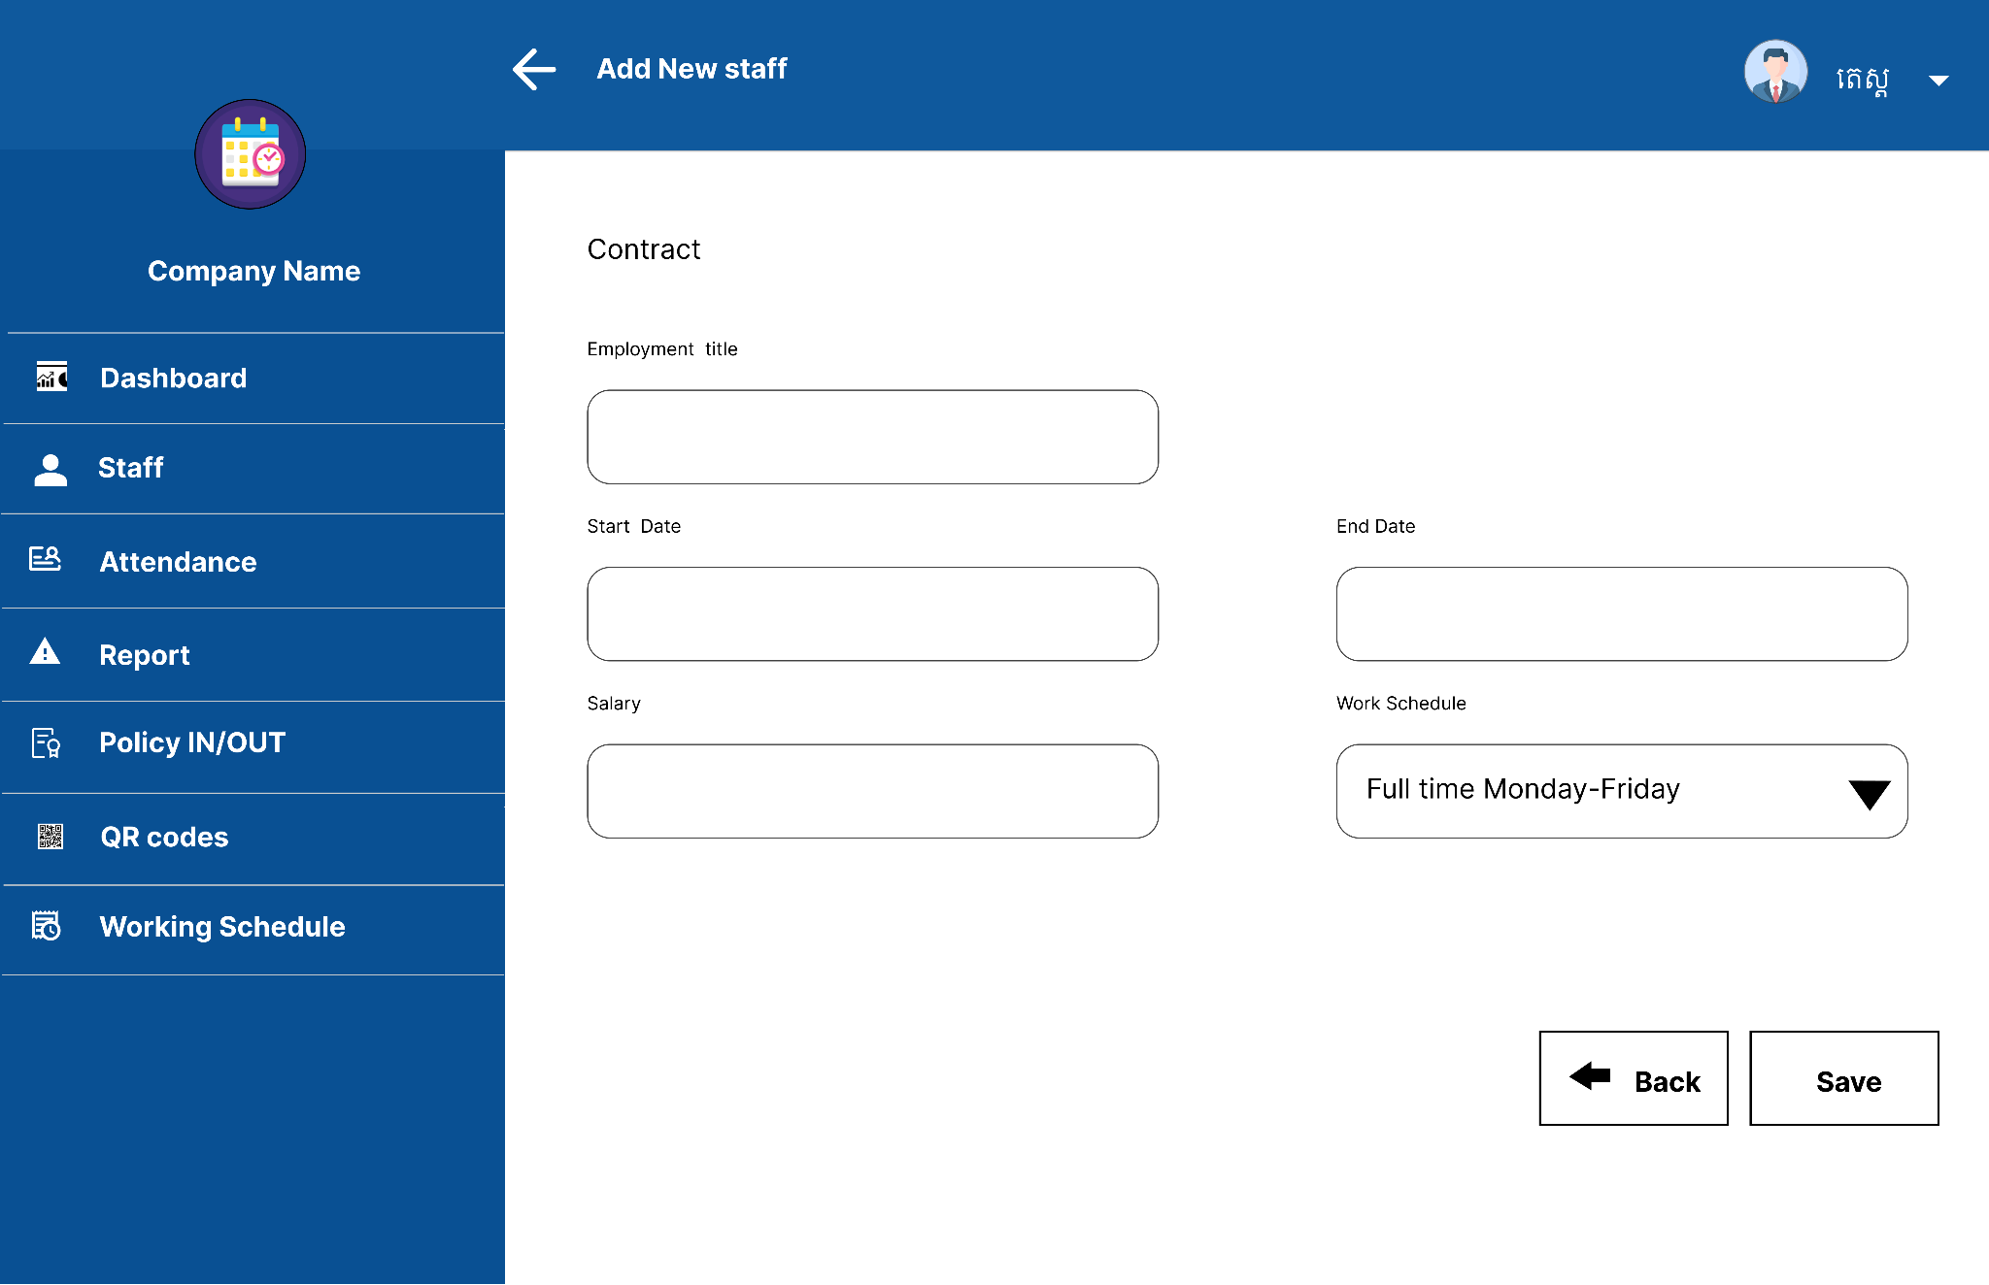
Add Staff

Slide 13
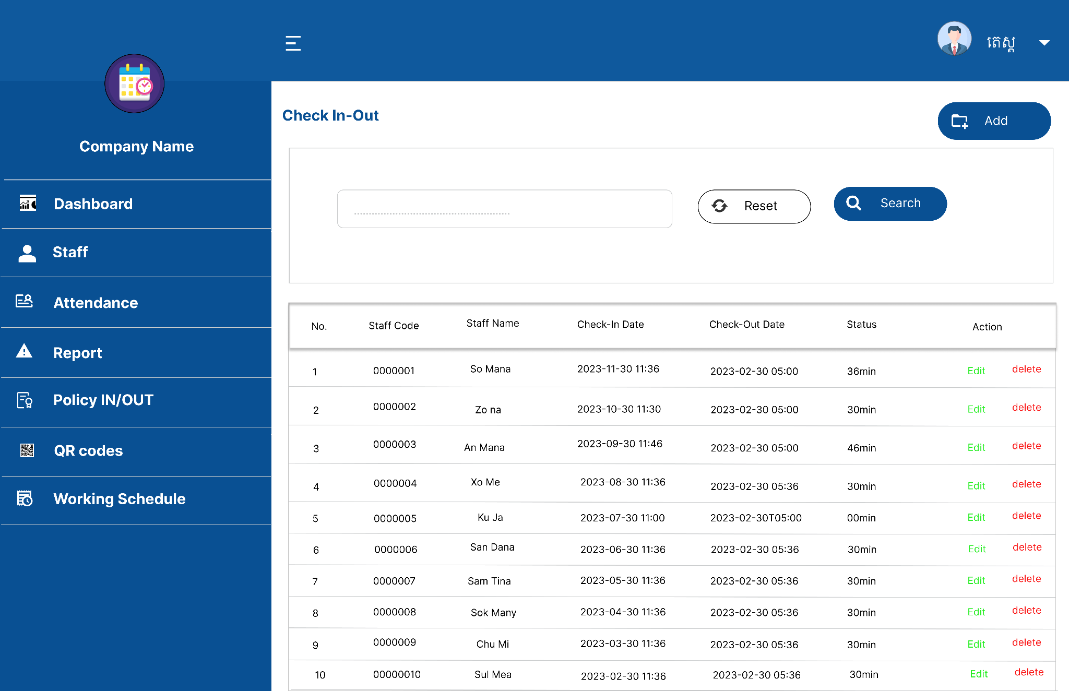
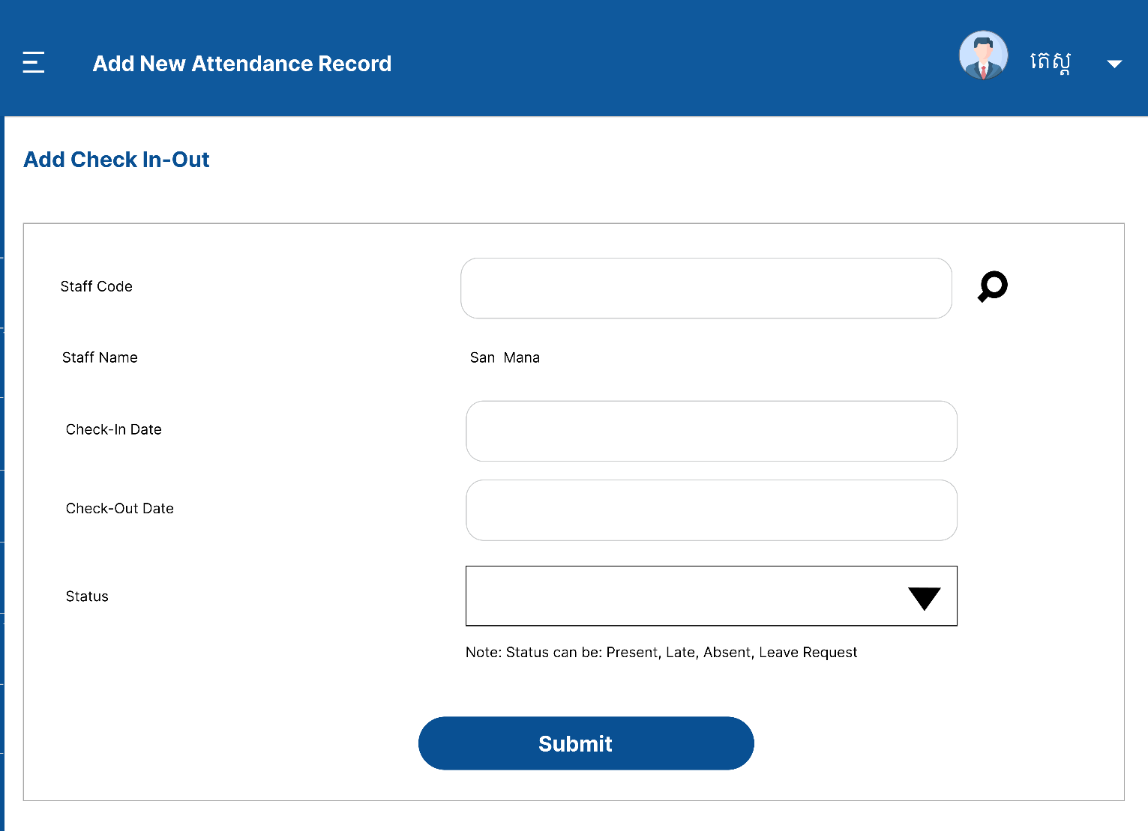
Attendance

Slide 14
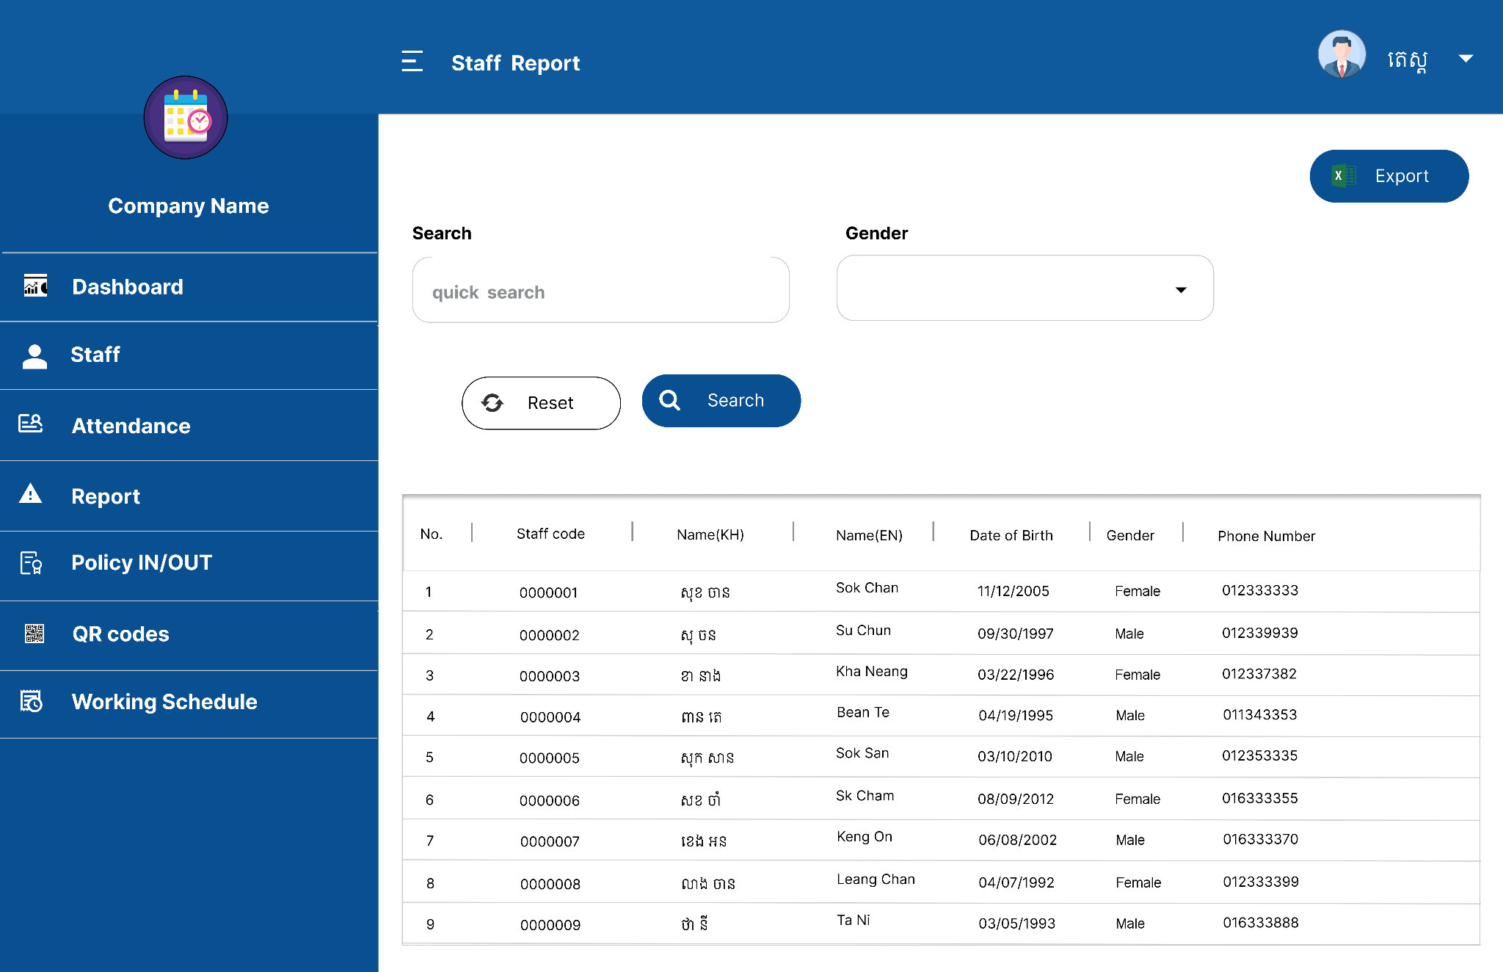
Reports

Slide 15
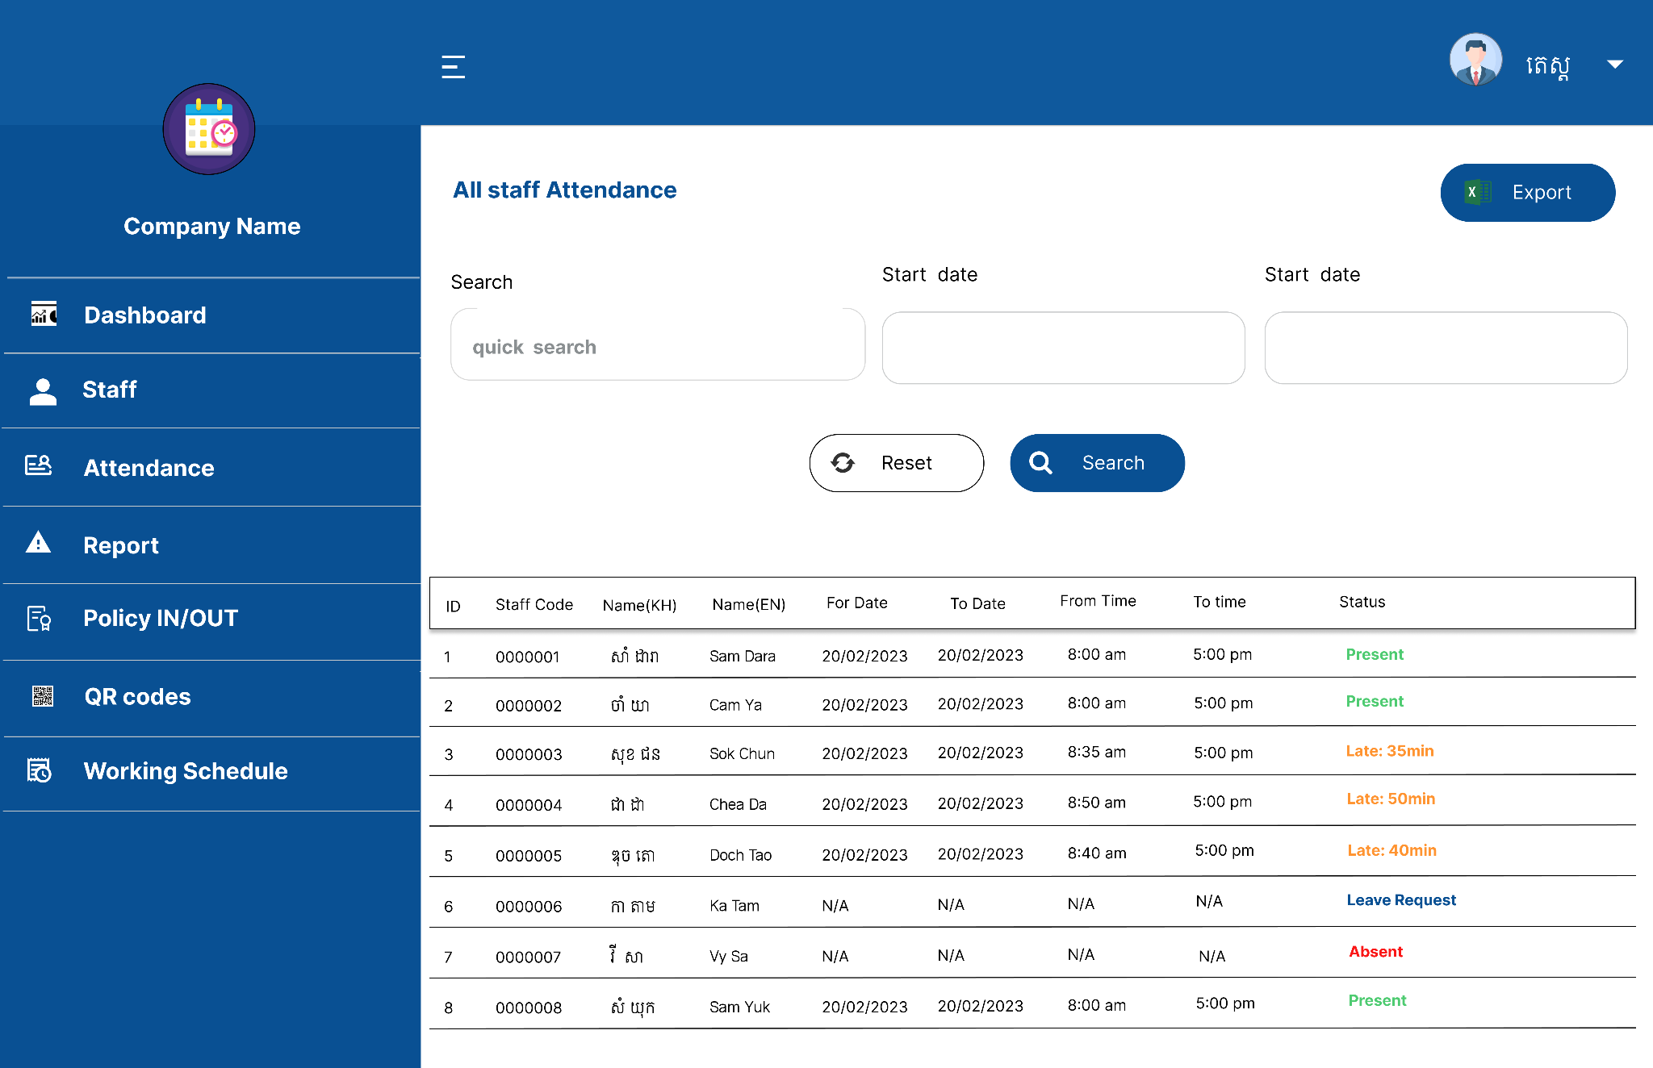
Reports

Slide 16
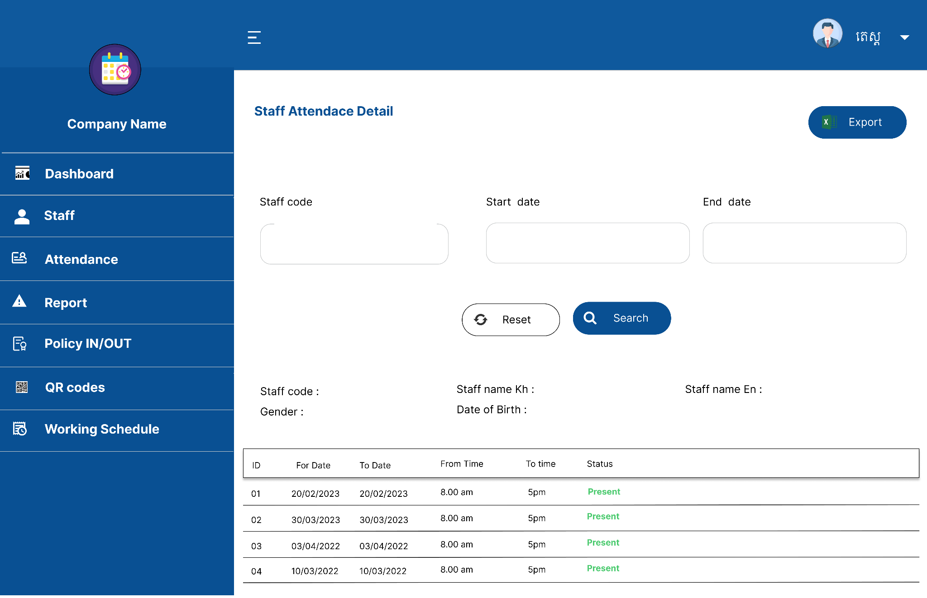
Reports

Slide 17
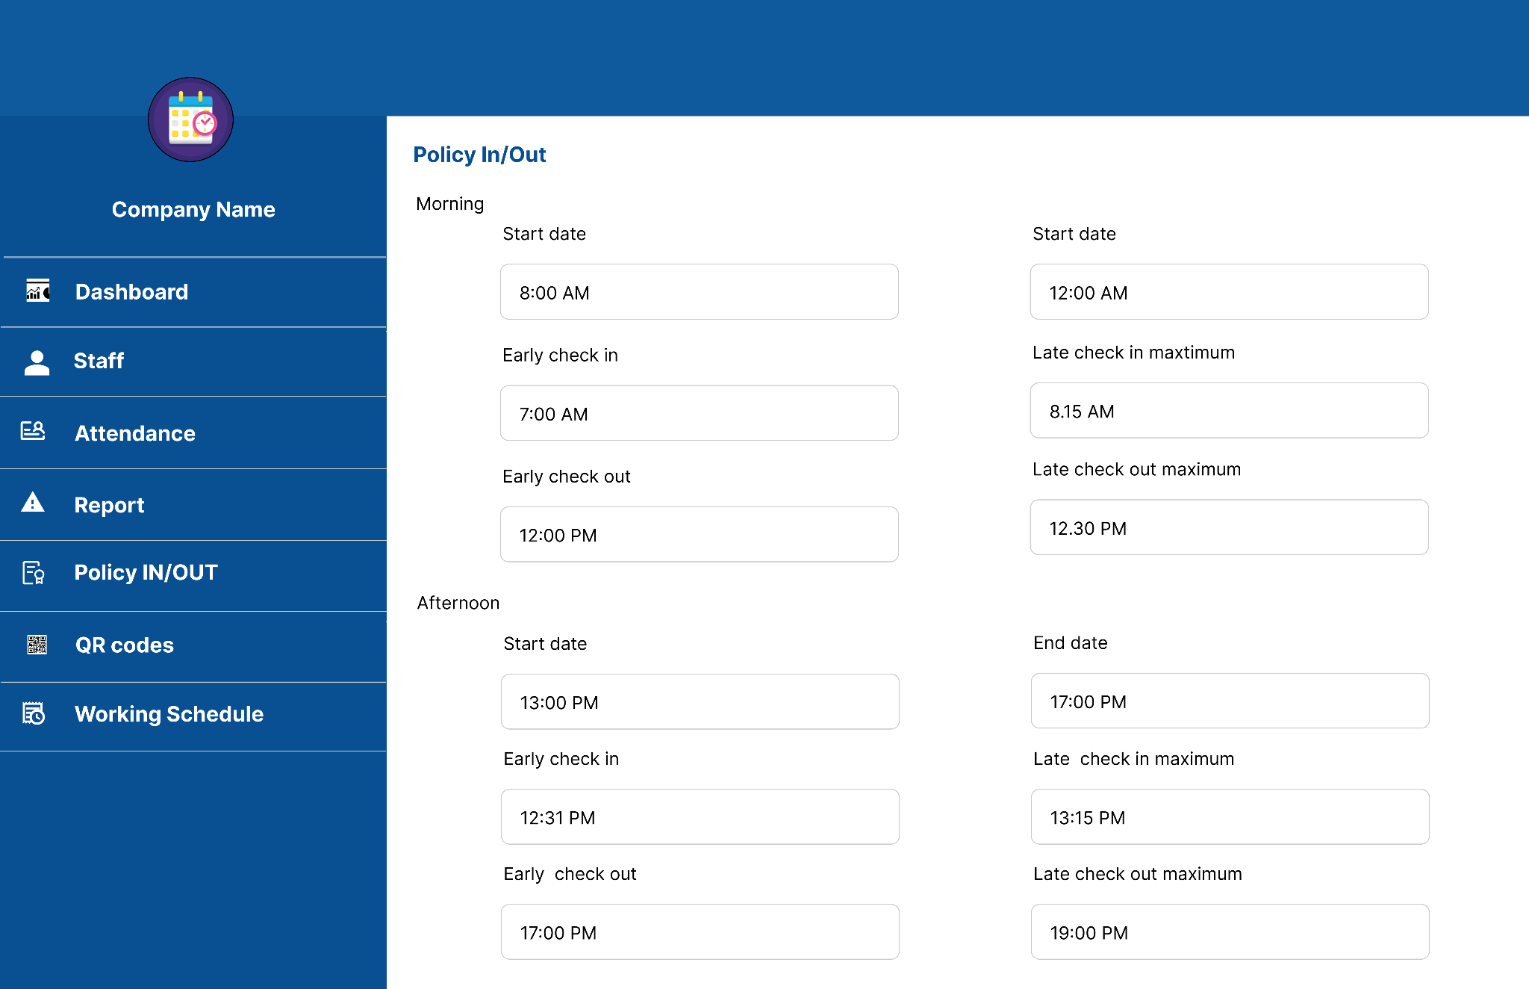
Policy IN/OUT

Slide 18
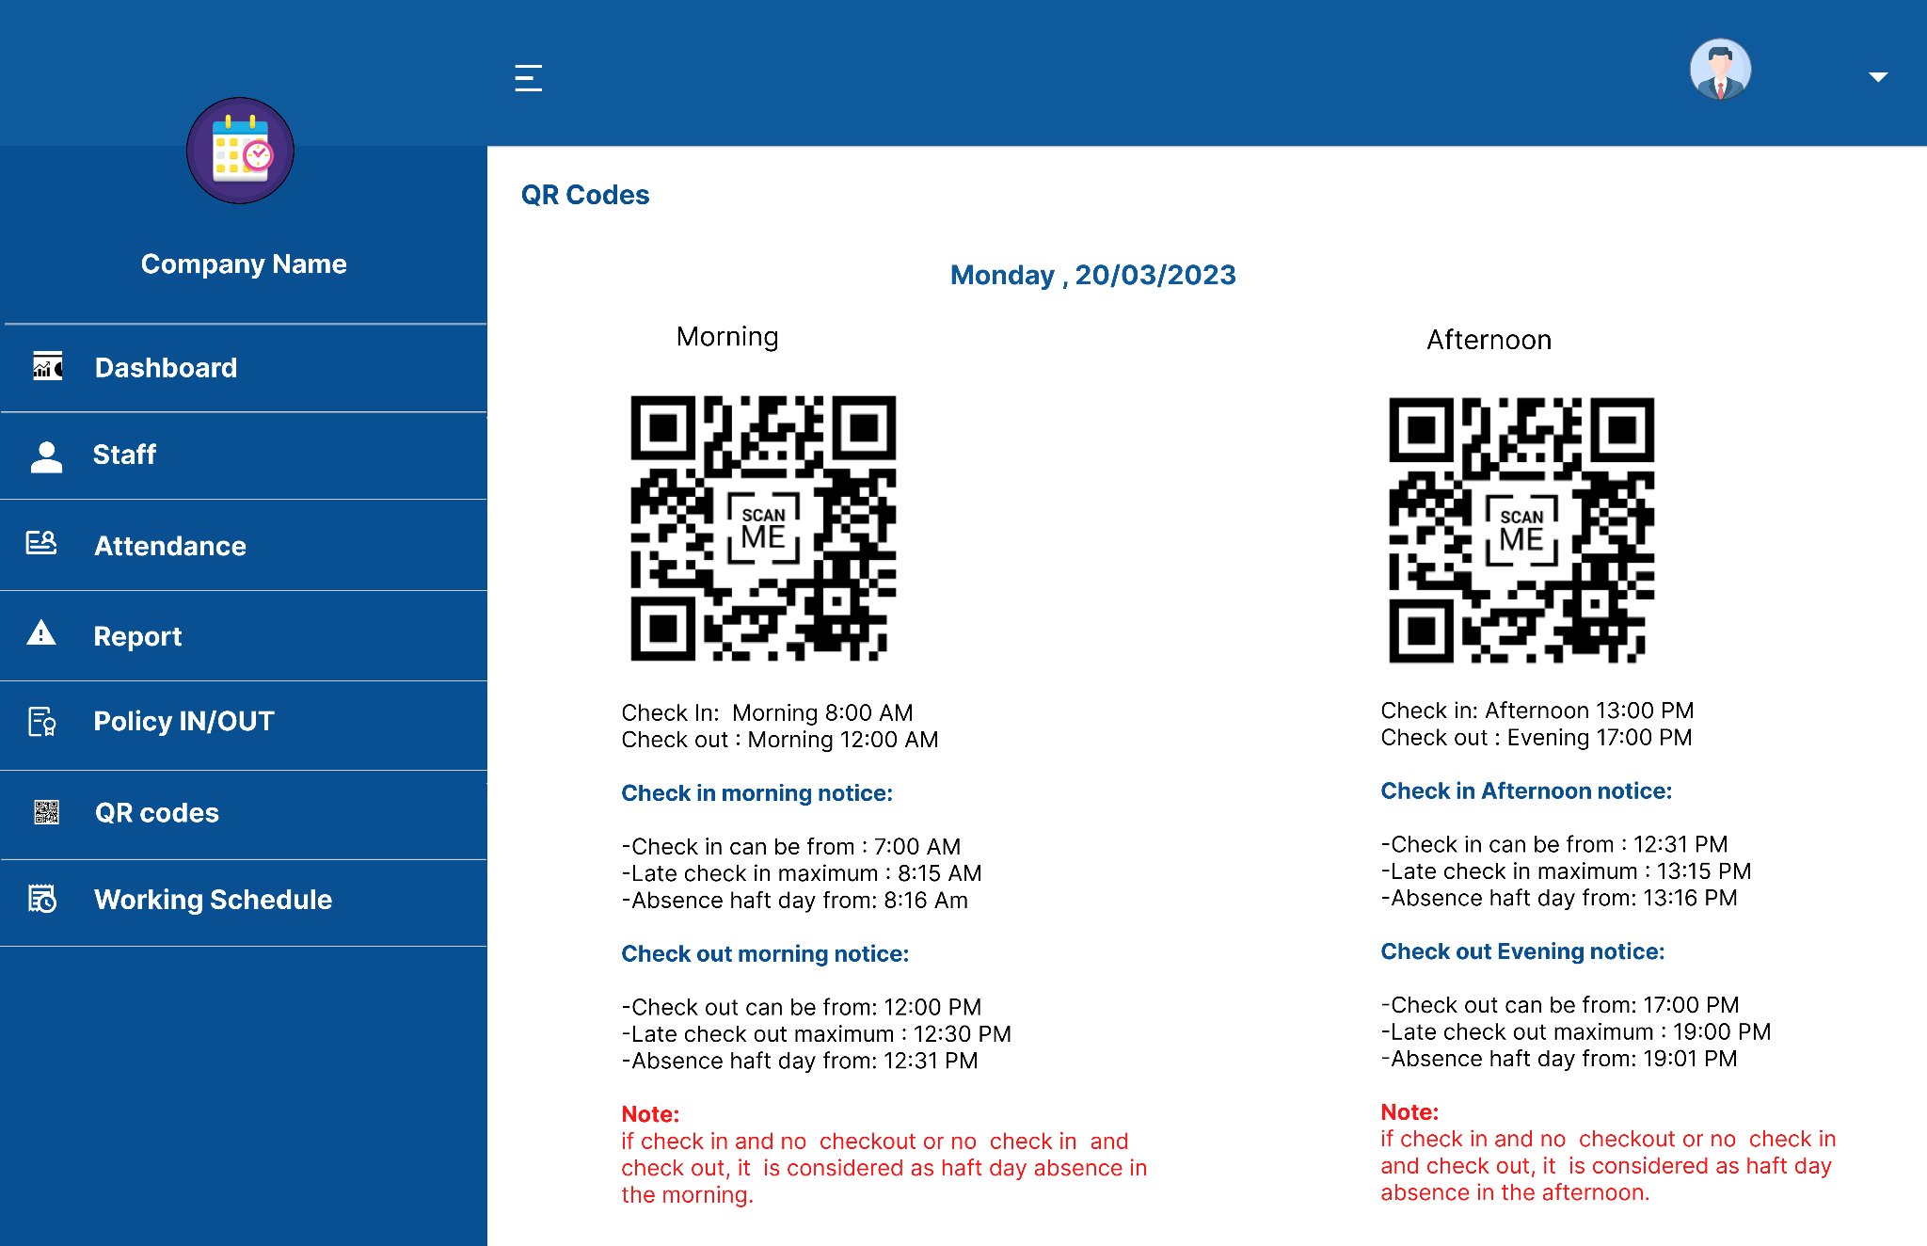
Policy IN/OUT Detail

Slide 19
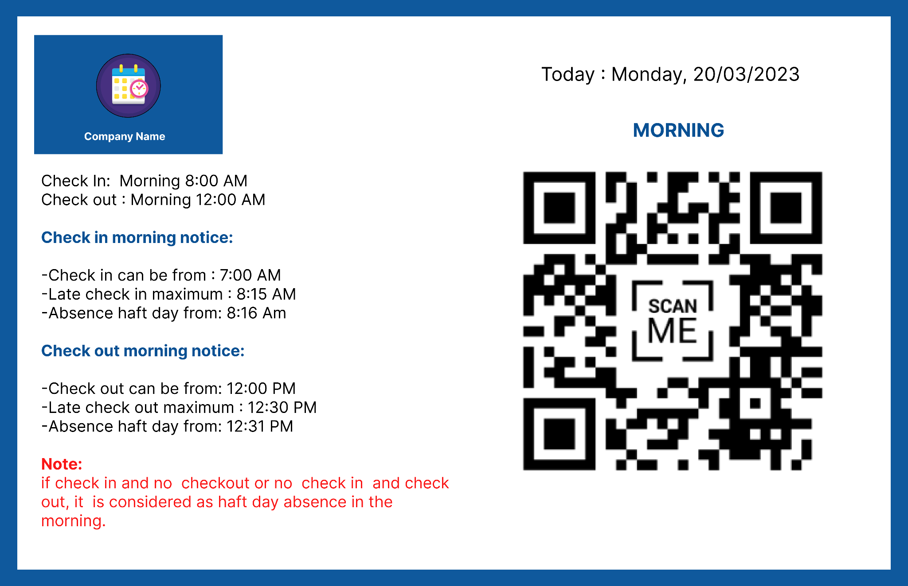
QR Code Scan

Slide 20
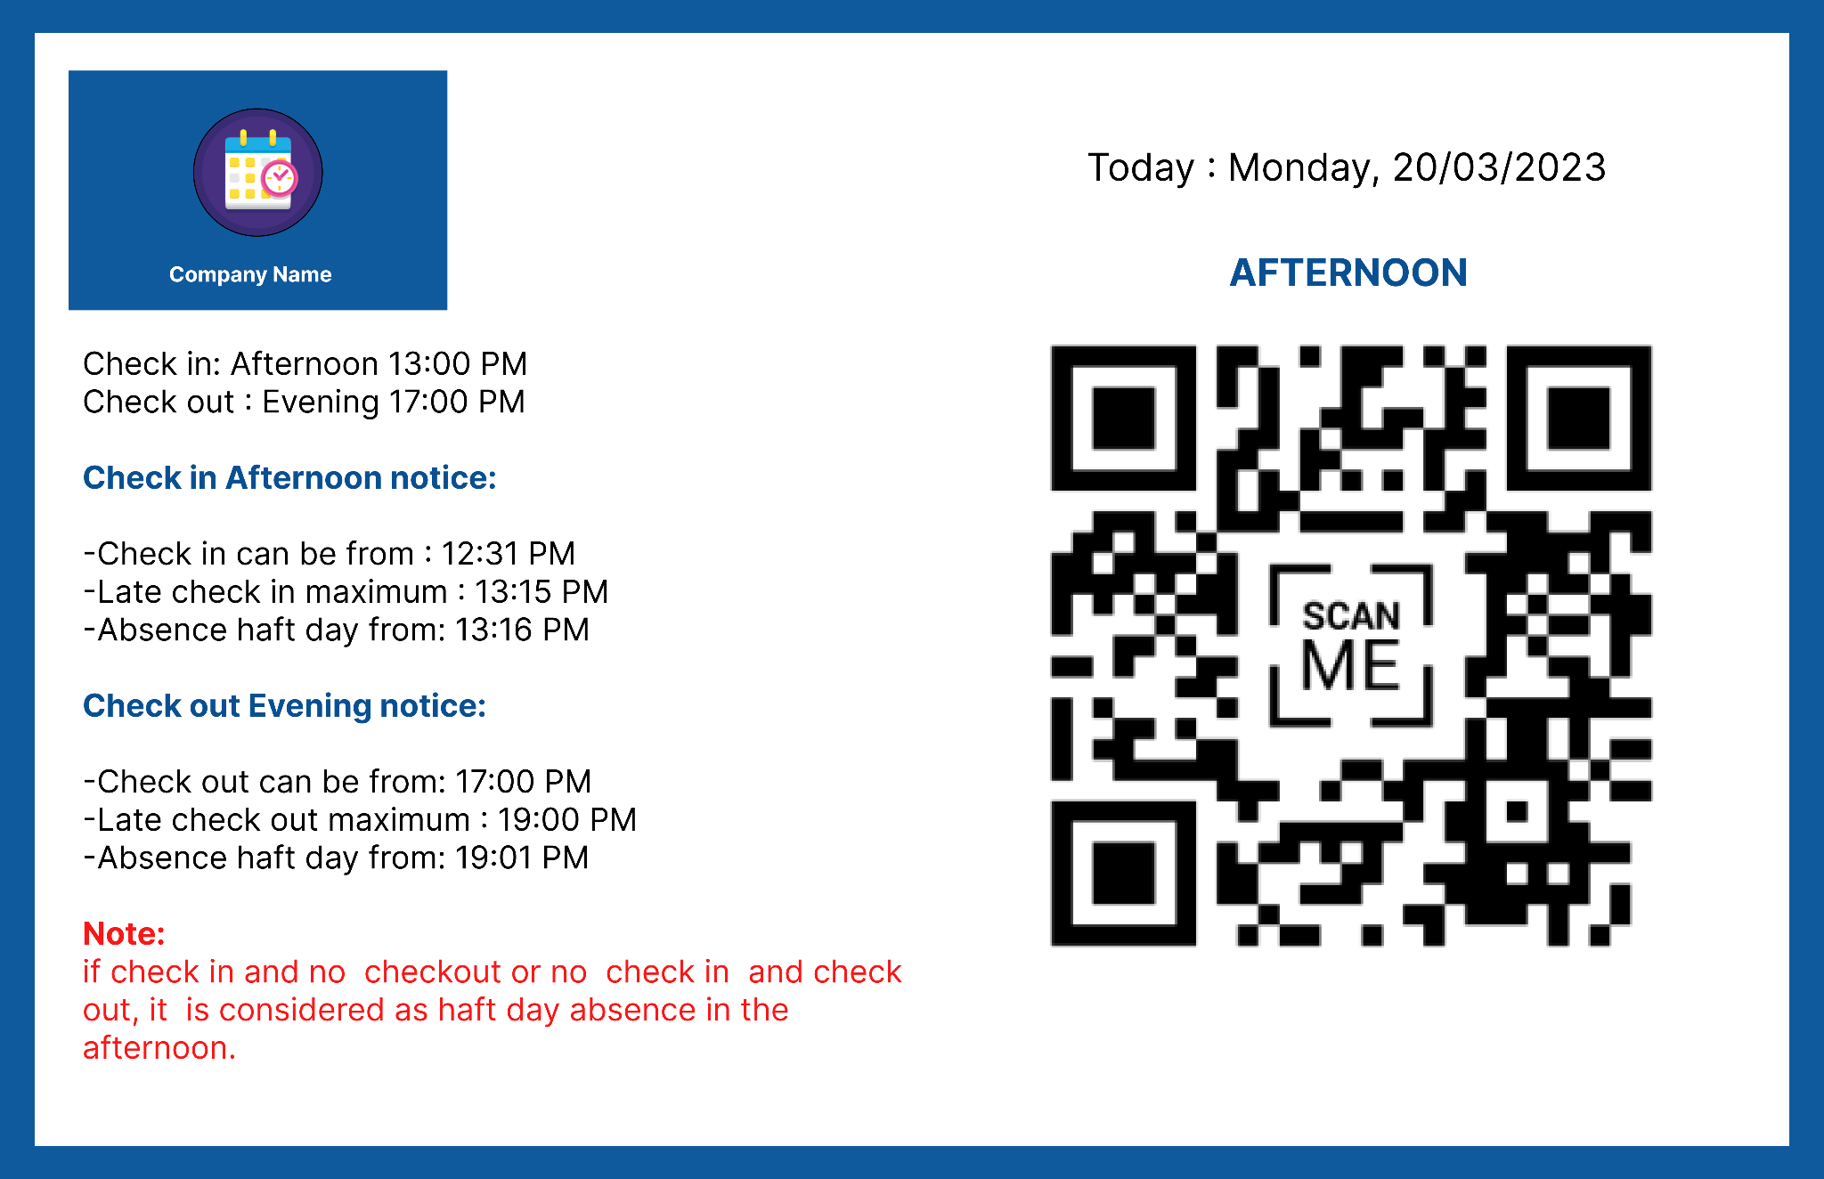
QR Code Scan

Slide 21
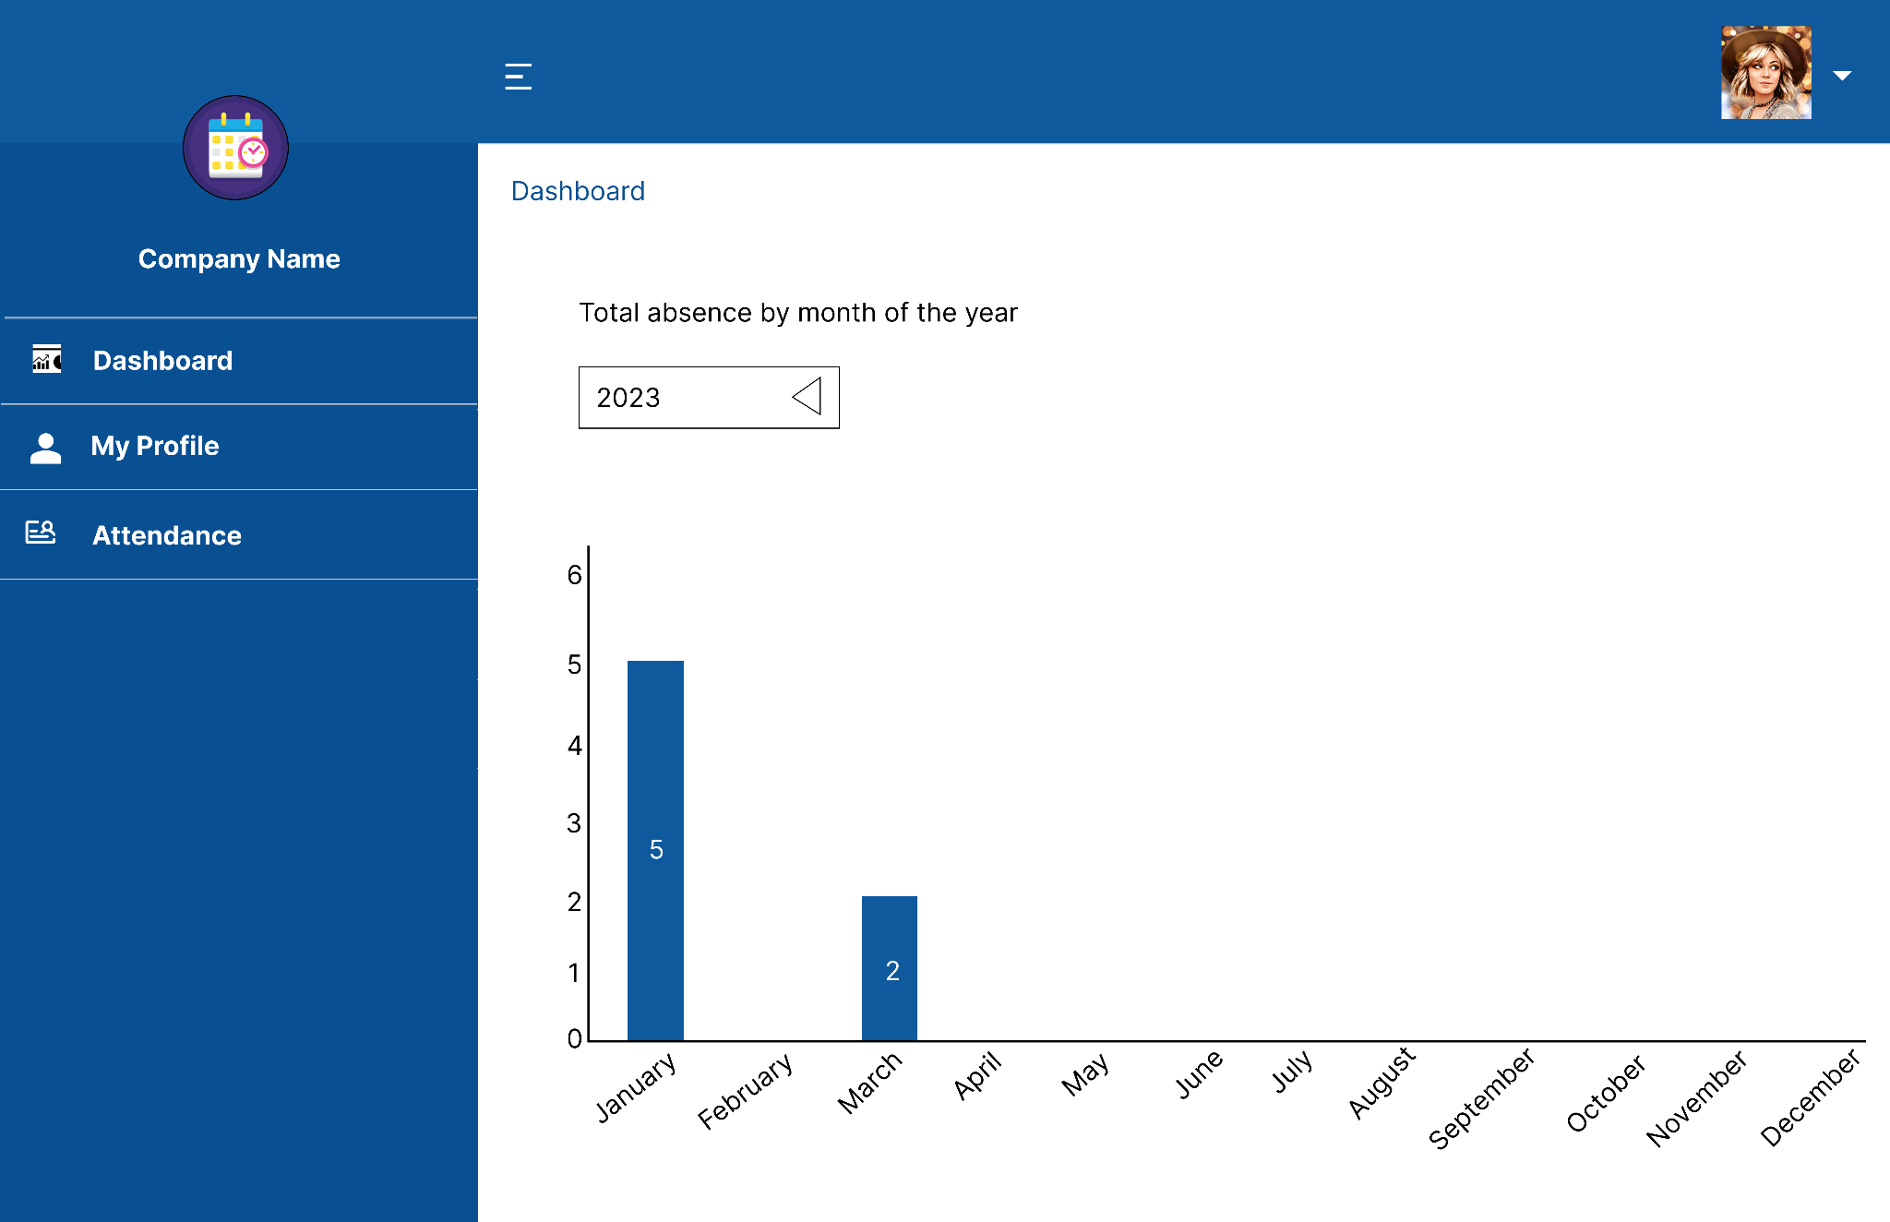
Employee Dashboard

Slide 22
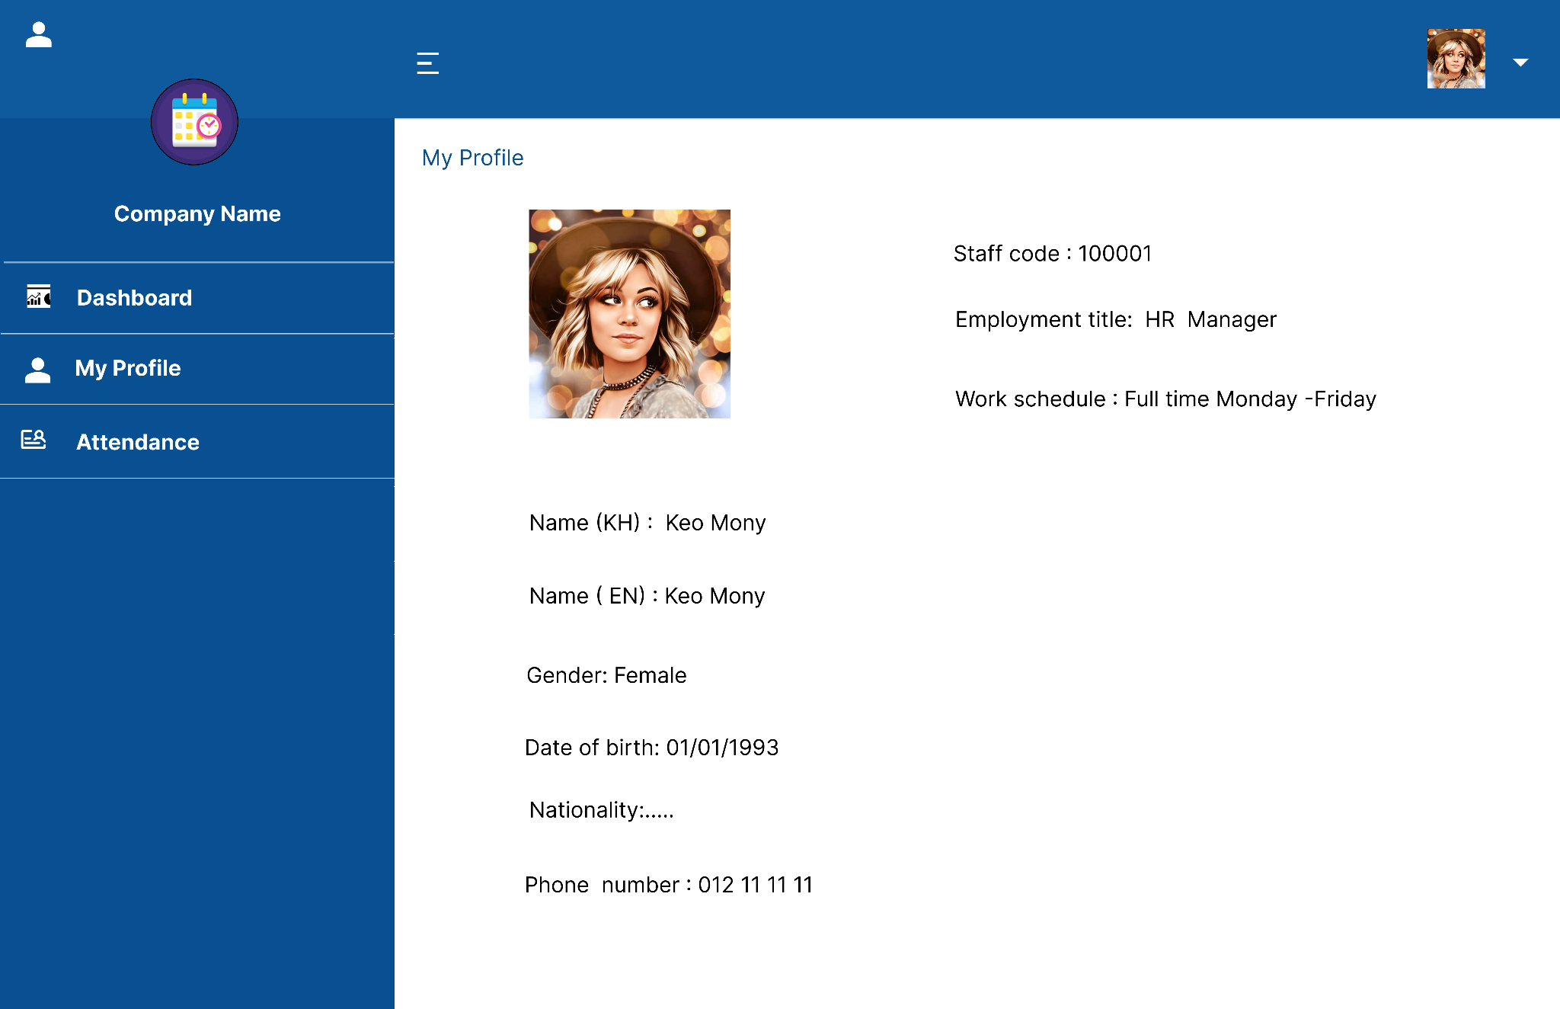
Employee Profile

Slide 23
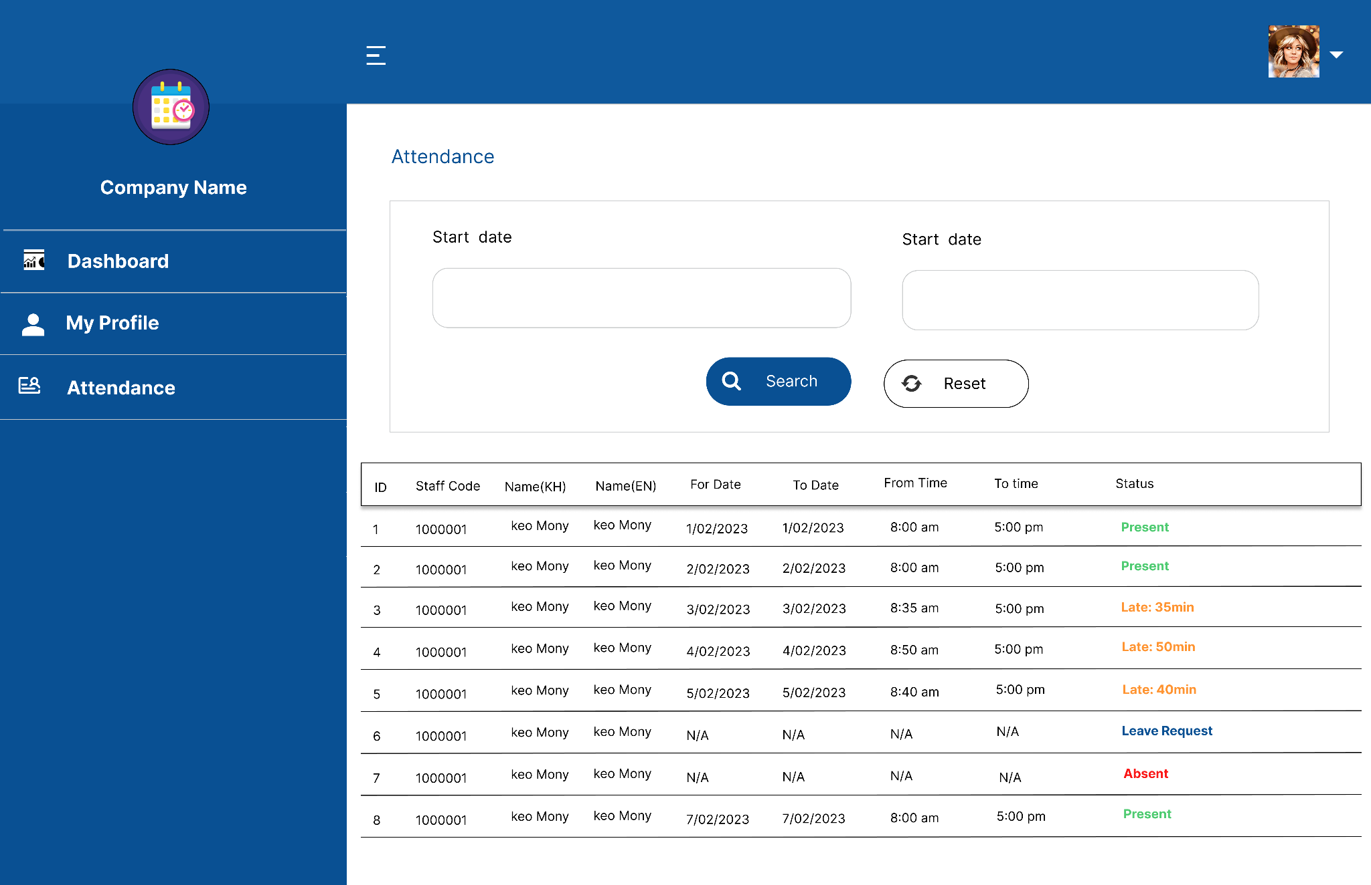
Employee Attendance

Slide 24
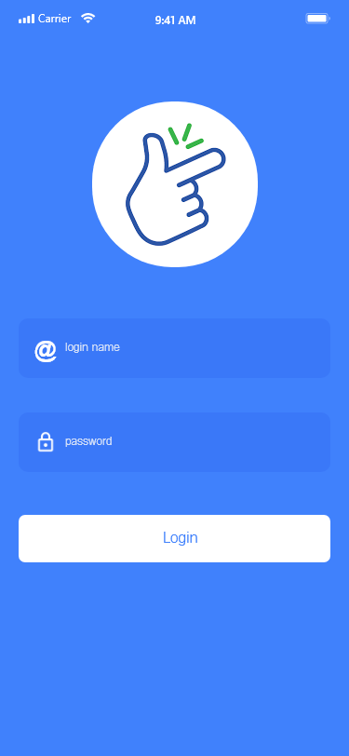
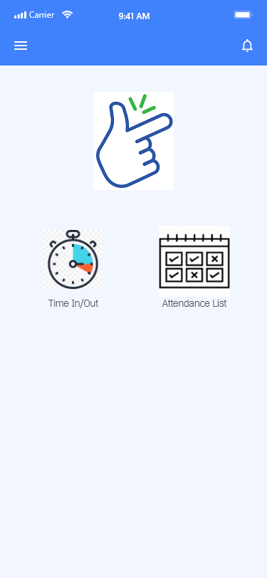
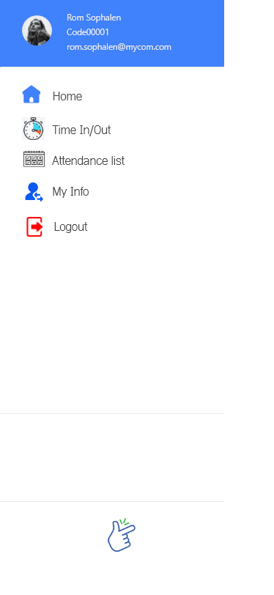
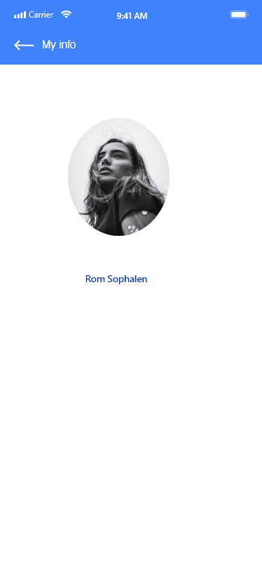
Prototype mobile

Slide 25
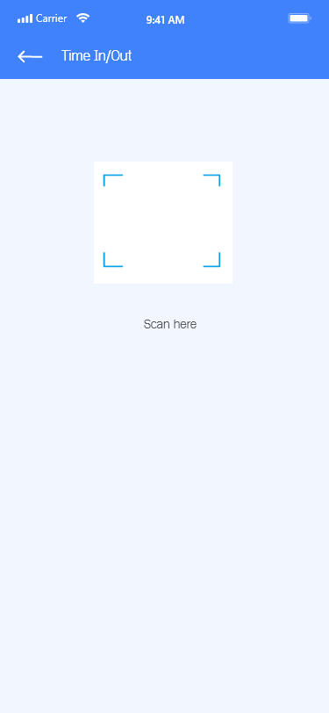
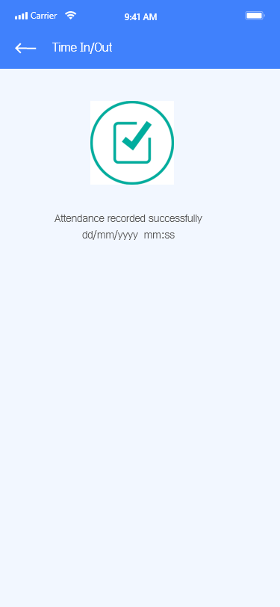
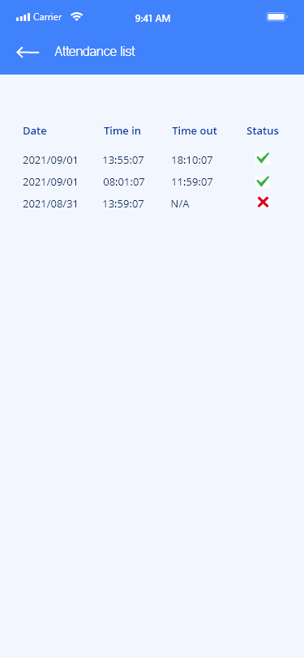
Prototype mobile

Slide 26

Progress
1. Have you had all documents references to do your topic?
2. Have you arrange all algorithms/pseudo codes to do your topic? Can you give a quick view in one page.
3. Have you structure your Core/API project yet? (e.g. existing API or spring boot)
4. Have you structure your Android project: Menu / Process activity screen etc.?
5. How many percentage now?

Slide 27
Progress
2. Have you arrange all algorithms/pseudo codes to do your topic? Can you give a quick view in one page.
3. Have you structure your Core/API project yet?
2
3
Company policy: 8am to 12am & 14pm to 18pm Generate office location: If the location is correct => attendance is recorded Attendance checking available: Morning: - In 7:30 am to 8:20am - Out 11:50 am to 12:30pm Afternoon - In 13:30pm to 14:20pm - Out 17:50 pm to 19:00pm | Technologies: API: Springboot db: Postgresql Mobile: Native

Slide 28
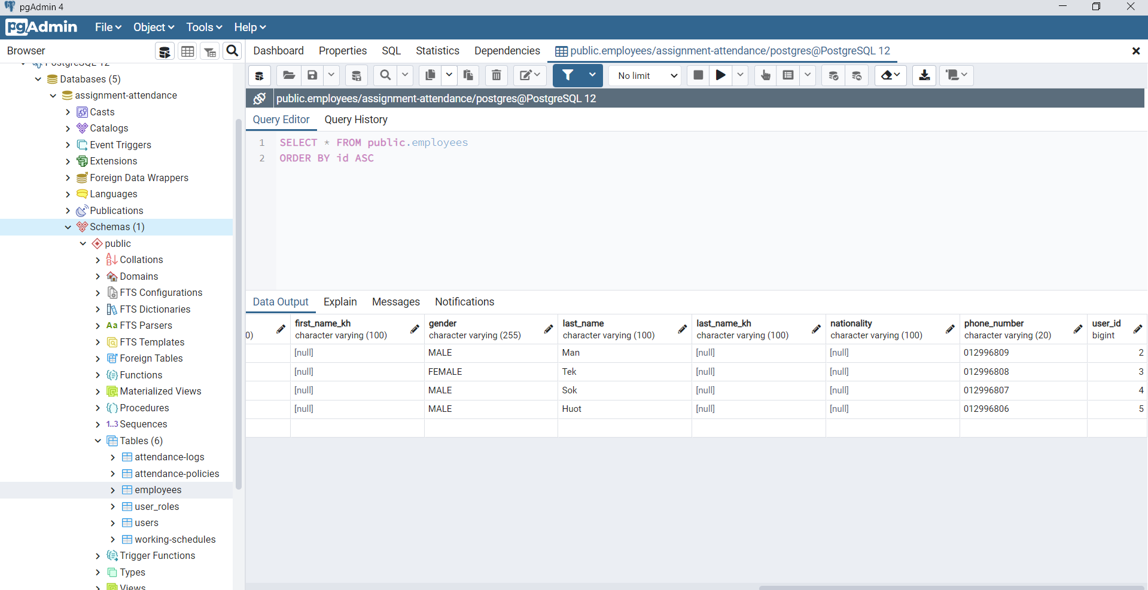
Database

Slide 29
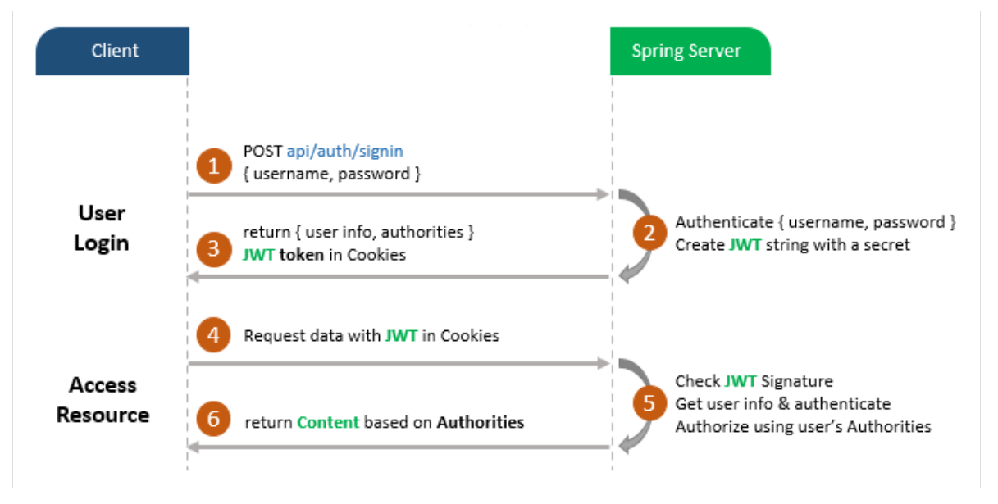
Flow of Spring Boot Security JWT example

Slide 30
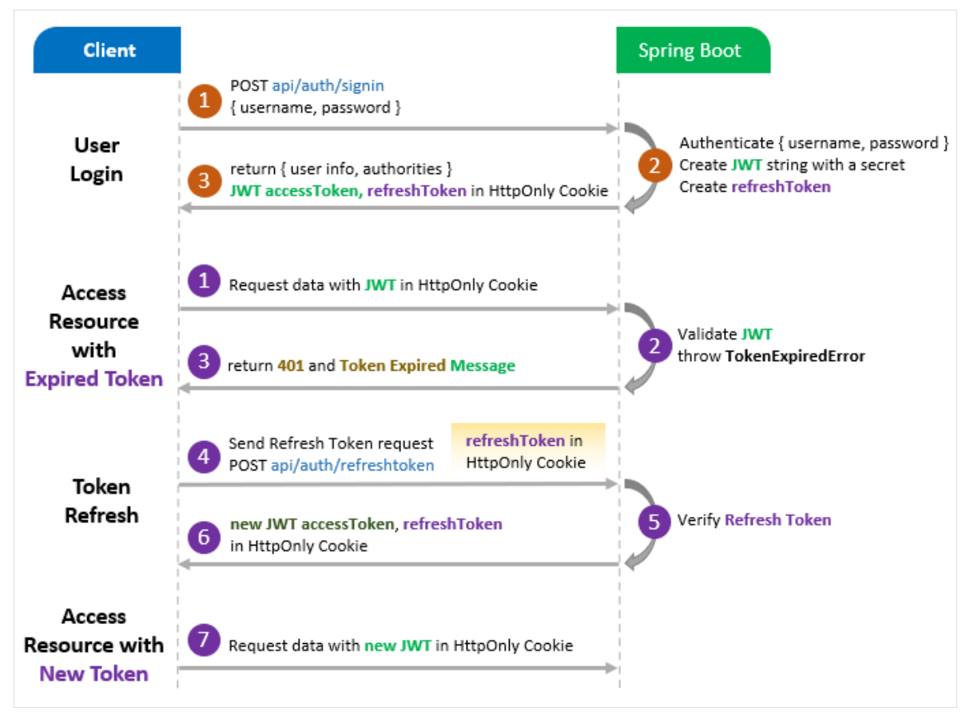

Slide 31
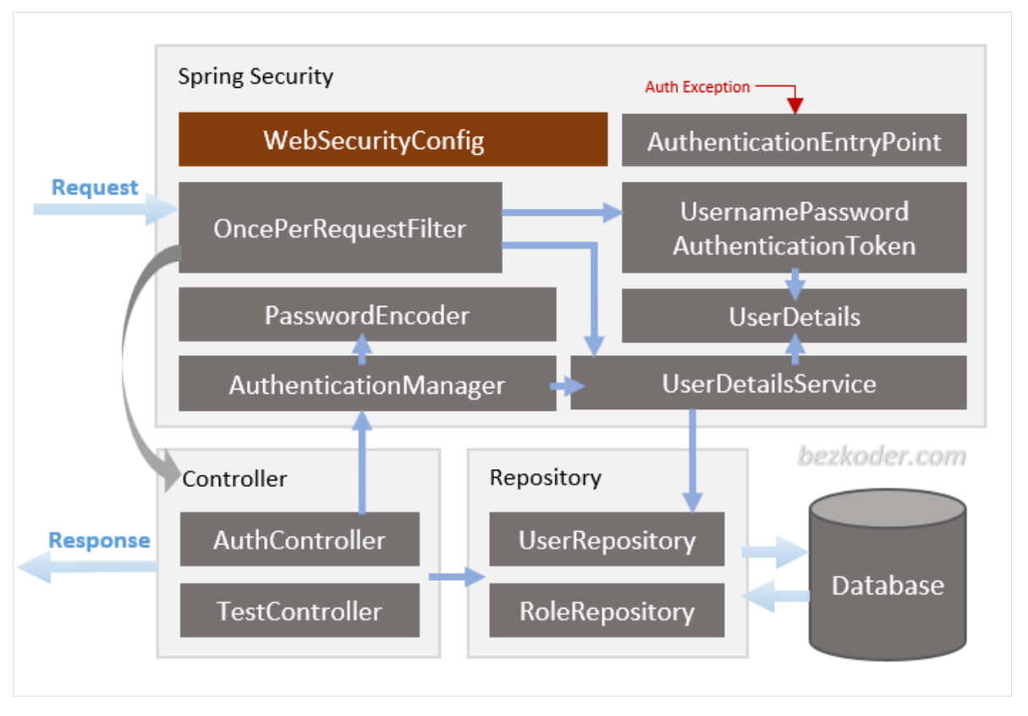
Spring Boot Architecture with Spring Security

Slide 32
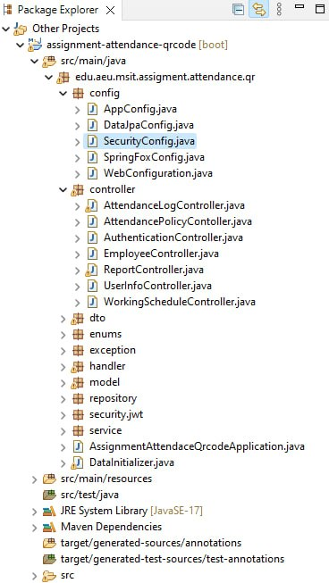
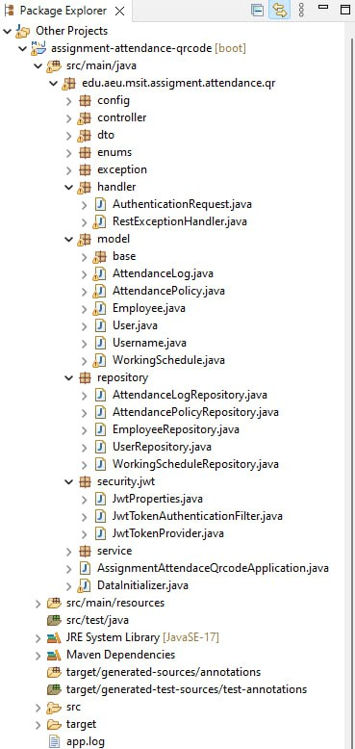
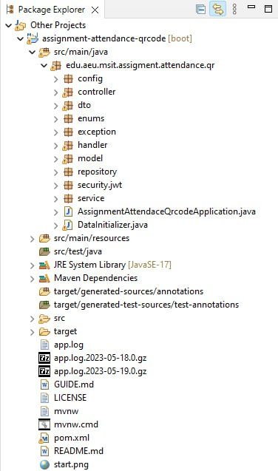
Project Structure

Slide 33


